Slide 1
ASYNCHRONOUS PROGRAMMING.
PART 2
By Mykhailo Torskyi

Slide 2
An asynchronous function is a function which operates asynchronously via the event loop, using an implicit Promise to return its result. But the syntax and structure of your code using async functions is much more like using standard synchronous functions

Slide 3
PROMISE
The ECMA Committee defines a promise as :
A Promise is an object that is used as a placeholder for the eventual results of a deferred (and possibly asynchronous) computation

Slide 4
CREATING PROMISES
new Promise(function(resolve, reject) { ... } );
The constructor accepts a function called executor. This executor function accepts two parameters: resolve and reject, which are in turn functions.

Slide 5
PromiseStatus can have three different values:
Pending
Resolved
Rejected
When a promise is created, PromiseStatus is in the pending status, it will have PromiseValue undefined until the promise is either resolved or rejected. When a promise is in resolved or rejected states, a promise is said to be settled. So a promise generally transitions from the pending state to the settled state

Slide 6
CODE TIME

Slide 7
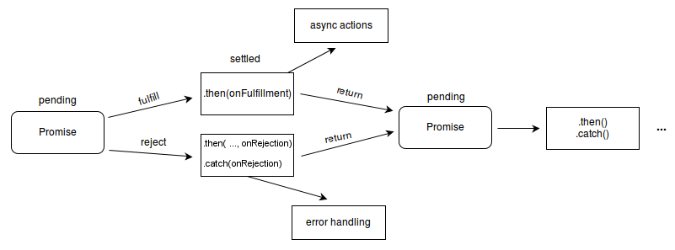

Slide 8
PROMISE METHODS
Promise.prototype.catch(onRejected)
Promise.prototype.then(onFulfilled, onRejected)
Promise.prototype.finally(onFinally)
Promise.resolve(value) - create a resolved promise
Promise.reject(reason) - create a rejected promise
Promise.all(iterable) - returns a single Promise that resolves when all of the promises in the iterable argument have resolved or when the iterable argument contains no promises
Promise.race - returns a promise that resolves or rejects as soon as one of the promises in the iterable resolves or rejects

Slide 9
RULES OF THUMB FOR USING PROMISES
Use promises whenever you are using async or blocking code.
Resolve maps to then and reject maps to catch for all practical purposes.
Make sure to write both .catch and .then methods for all the promises.
If something needs to be done in both cases, use .finally.
Only get one shot at mutating each promise.
We can add multiple handlers to a single promise.
In Promise.all the order of the promises is maintained in the values variable, irrespective of which promise was first resolved.

Slide 10
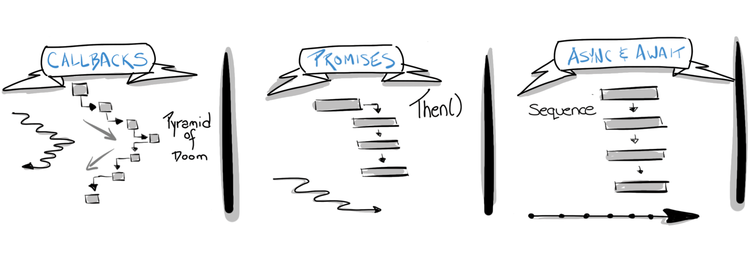
ASYNC/AWAIT

Slide 11
GENERAL SYNTAX OF USING ASYNC-AWAIT
async function testAsync() {
for (var i = 0; i < 5; i++) {
try {
result1 = await somePromise();
console.log("Result 1 ", result1);
result2 = await somePromise();
console.log("Result 2 ", result2);
}
catch (e) {
console.log("Error", e);
} finally {
console.log("This is done");
}
}
}

Slide 12
Async functions return a promise
Async functions use an implicit Promise to return results. Even if you don’t return a promise explicitly, the async function makes sure that your code is passed through a promise
Await blocks the code execution within the async function, of which it (await statement) is a part
There can be multiple await statements within a single async function
When using async await, make sure to use try catch for error handling
If your code contains blocking code it is better to make it an async function. By doing this you are making sure that somebody else can use your function asynchronously

Slide 13
By making async functions out of blocking code, you are enabling the user (who will call your function) to decide on the level of asynchronicity they want.
Be extra careful when using await within loops and iterators. You might fall into the trap of writing sequentially executing code when it could have been easily done in parallel.
await is always for a single promise. If you want to await multiple promises (run this promise in parallel) create an array of promises and then pass it to the Promise.all function.
Promise creation starts the execution of asynchronous functionality.

Slide 14
GENERATOR
Generators are functions that can be exited and later re-entered. Their context (variable bindings) will be saved across re-entrances.
Generators in JavaScript - especially when combined with Promises - are a very powerful tool for asynchronous programming as they mitigate

Slide 15
SYNTAX
function* declaration defines a generator function, which returns a Generator object.
The yield keyword is used to pause and resume a generator function
yield* expression is used to delegate to another generator or iterable object.

Slide 16


